Slide 1
Ch- 8. Class Diagrams
Class diagrams are the most common diagram found in modeling object- oriented systems.
Class diagrams are important not only for visualizing, specifying, and documenting structural models, but also for constructing executable systems through forward and reverse engineering.

Slide 2
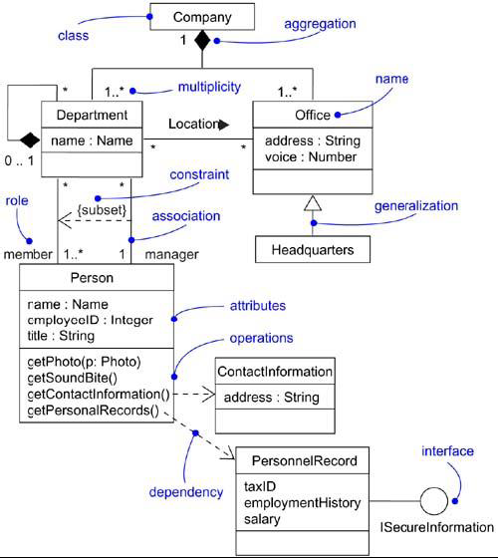
Class Diagram

Slide 3
A class diagram is a diagram that shows a set of classes, interfaces, and collaborations and their relationships.
Graphically, a class diagram is a collection of vertices and arcs.

Slide 4
Class diagrams commonly contain the following things:
Classes
Interfaces
Collaborations
Dependency, generalization, and association
relationships.
Like all other diagrams, class diagrams may contain notes and constraints.

Slide 5
Class diagrams may also contain packages or subsystems, both of which are used to group elements of your model into larger chunks.
Class diagrams are used to model the static design view of a system. This view primarily supports the functional requirements of a system- the services the system should provide to its end users.

Slide 6
When you model the static design view of a system, you'll typically use class diagrams in one of three ways.
To model the vocabulary of a system
Modeling the vocabulary of a system involves making a decision about which abstractions are a part of the system under consideration and which fall outside its boundaries. You use class diagrams to specify these abstractions and their responsibilities.

Slide 7
2. To model simple collaborations
A collaboration is a society of classes, interfaces, and other elements that work together to provide some cooperative behavior that's bigger than the sum of all the elements.
For example, when you're modeling the semantics of a transaction in a distributed system, you can't just stare at a single class to understand what's going on. Rather, these semantics are carried out by a set of classes that work together.

Slide 8
3. To model a logical database schema
Think of a schema as the blueprint for the conceptual design of a database. In many domains, you'll want to store persistent information in a relational database or in an object-oriented database.

Slide 9
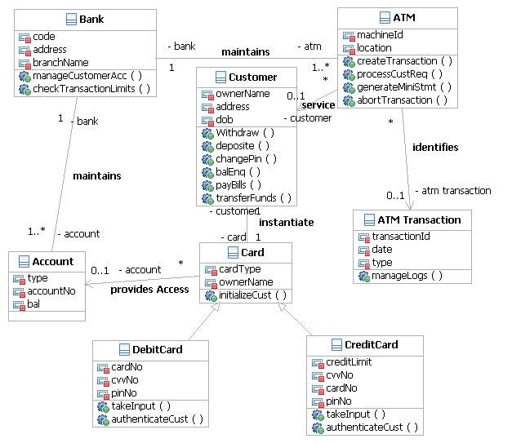
ATM Class Diagram

